Slide 1

Happy Monday
Take your name tag
Check in on iClicker

Slide 2

Get your name tag Check-in

Slide 3
iClicker Question
Parameter is characteristic or measure of a sample
True
False

Slide 4

iClicker Question
Sampling error
Decreases with increasing sample size
Increases with increasing sample size

Slide 5

iClicker Question
Nonprobability sampling allows us to calculate sampling error
True
False

Slide 6
iClicker Question
Knowing that you need a sample pool of 500 students to ultimately get about 250 students in your sample, you are in a position to draw a systematic sample from the student directory at your university. Further, 10,000 students are listed in the directory
10
15
20
Notes:
K = number of elements in sampling frame / total sampling elements
TSE = sample size / ()

Slide 7
iClicker Question
Stratified sampling requires strata to be homogeneous within, but heterogenous between
True
False

Slide 8
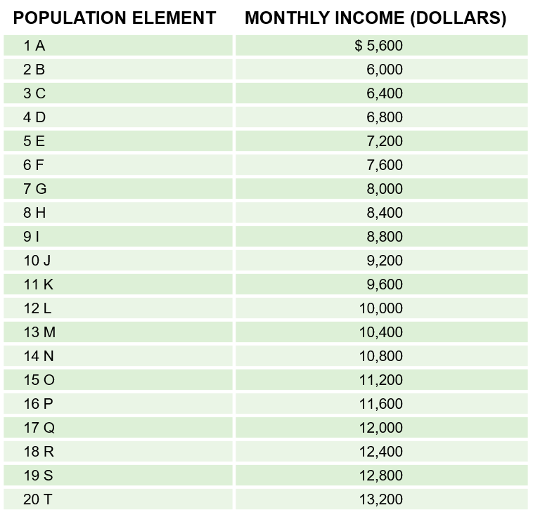
Basics of the Sampling Distribution
EXHIBIT 14A.1 Population
Population Mean (μ) = $9400

Slide 9
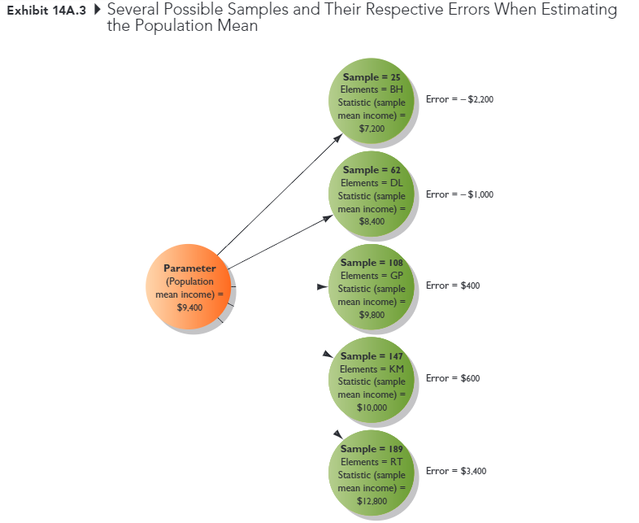
Basics of the Sampling Distribution
Derived population
All possible sample that can be drawn from the population under a given sampling plan

Slide 10
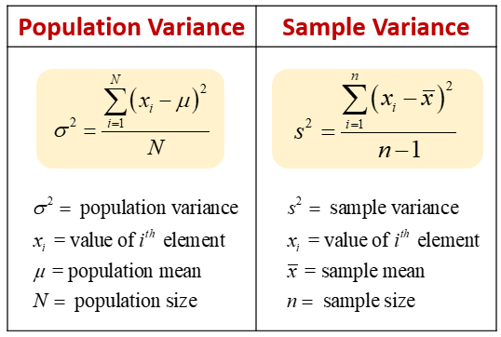
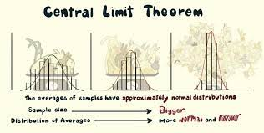
Basics of the Sampling Distribution
The mean of all possible sample means is equal to the population mean
The variance of the sample means is related to the population variance
The sampling distribution is mound shaped
Consistent with the Central-Limit Theorem, regardless of the shape of the distribution of the variable in the population, with a sample size of 30, the distribution of sample means becomes normally distributed
Link for visualization
Notes:
Sample variance is higher than population variance.
The logic of doing that is to compensate our lack of information about the population data.
https://rstudio.cloud/project/2980145
Sampling_dist
It is impossible to find out variance of heights in human beings, for our absolute lack of information about heights of all living human beings, not to talk about the future. Even if we take one moderate example, like population data on heights of all the living men in US it is physically possible, but the cost and time involved in this would defeat the purpose of its calculation.

Slide 11

Chapter 15: Data Collection: Enhancing Response Rates while Limiting Errors

Slide 12
Learning Objectives
Describe the 6 types of error that can enter a study
1
Give the general definition for response rate
2
Discuss several ways in which response rates might be improved
3
Notes:
This chapter is rather short, but it can greatly aid you in your data collection process

Slide 13
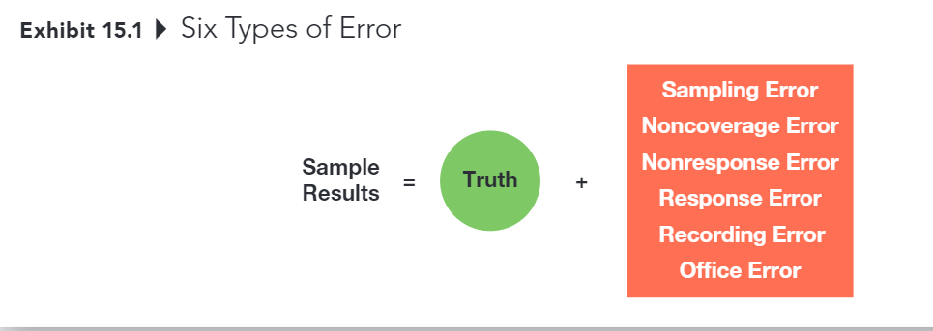
Six Types of Error
Notes:
There are 6 types of errors that can enter into your sample result that prevent you from seeing the truth, which is whatever you want to measure with the survey
They are …

Slide 14
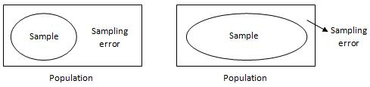
Sampling Error
The difference between results obtained from a sample and results that would have been obtained had info been gathered from or about every member of the population.
Decreased by increasing sample size
Can be estimated (assuming probability sample)
Usually less troublesome than other kinds of error
However, sampling error usually isn’t the biggest problem – it’s all the other things that contribute to error a project.
And these other sources of error can’t be accounted for statistically …
Notes:
The first one is sampling error
So we talked a little about this error in the last class.
If you can recall, we draw sample from a population
With probability sampling, we can easily handle this type of error from formulas

Slide 15
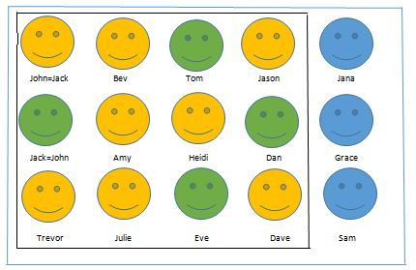
Noncoverage Error
Error that arises because of failure to include qualified elements of the defined population in the sampling frame
Noncoverage error is essentially a sampling frame problem
This Photo by Unknown Author is licensed under CC BY-SA
Notes:
The second type of error is noncoverage error
This error arises because of failure to include qualified elements of the defined population in the sampling frame
When conducting your survey, you have to first decide your sampling frame right, but you might forget some aspects of you population, or you might exclude a group of people that are supposed to be in your sample as well.
For example, you want to survey the US population as a whole, but somehow your survey systematic miss naturalized US citizens, in which case, your sample would not be representative of the whole population right?

Slide 16
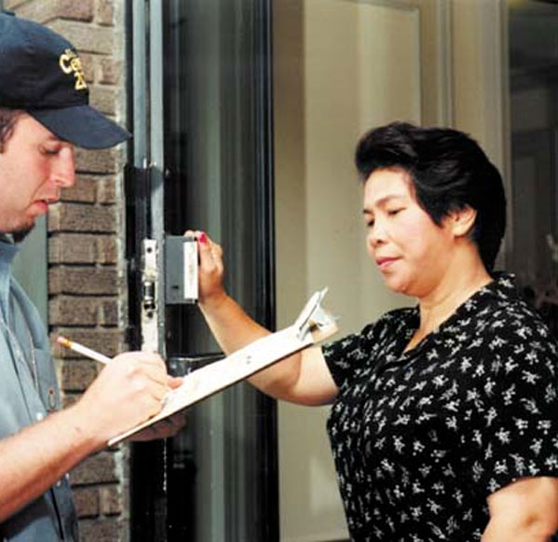
Nonresponse Error
Error from failing to obtain info from some elements of the population that were selected and designated for the sample
This is a potential problem that only occurs when those who respond are systematically different in some important ways from those who don’t respond
Notes:
The third type of error is nonresponse error.
This type of error is usually encountered in any communication –based project.
It’s the error from failing to obtain …
It’s a potential problem, because it can create systematic difference between those who respond, and those who do not respond.
We will also cover the methods to assess and counter this method. But there is no fool-proof plan against this type of error (or at least with our current state-of-the-art)

Slide 17

Nonresponse Error - Example
Suppose that a university wanted to assess the success of its graduates, based on their annual salaries, 5 years after graduation
Which graduates are more likely to return a survey?
(Those who are happy with their salaries)
Which graduates are less likely to return a survey?
(those who are not happy with their salaries)
Notes:
Say that you want to assess the success of Mizzou’s graduates based on their annual salaries within 5 years after graduation.

Slide 18


Primary Sources of Nonresponse Error
Refusals
Not-at-Homes
Notes:
It’s better to work hard at generating responses from a smaller sampling pool than to start with a much larger sampling pool and ignore potential nonresponse error, even if the resulting sample size is smaller
Pay attention to the response rates delivered by different online panel companies. The completion rate is not the same thing as the overall response rate!
For example. if 1000 persons were asked to take part in a survey, 100 of them accepted and 90 actually completed the questionnaire then the response rate is 10% (RR=100/1000) and the completion rate is 90% (CR=90/100). Completion rate can provide information about survey instrument - if certain questions are not filled in more often then some other (i.e. have lower completion rate) then they are probably sensitive and if the interviewing is stopped or interrupted after some time then it is likely that survey procedure is exhausting (long questionnaire, for example).
This bias mostly comes from the fact that people refuse to participate in your study
And the rate of refusals depends on many factor.
But in practice, personal interviews seem to have the lowest rate of refusals because of the social nature of the contact.
A respondent doesn’t run the risk of hurting someone’s feelings by deleting an email message or throwing a mail survey in a trash can , or during phone interview, interviewers can’t use the interpersonal nature of conversations to their advantage.
It’s important that you usually have to make multiple requests. That’s why you might see companies asking for your response multiple times.
Another nonresponse bias can creep in when you do phone interview, which is classified as not-at-homes.

Slide 19

3 Methods for Diagnosing Nonresponse Error
Contact a sample of nonrespondents
Compare respondent demographics against known demographics of the population
Conduct an analysis of late responders vs. early responders (this method is very controversial)
Notes:
There are 3 methods to assess your nonresponse error
First you can contact a sample of nonrespondents, either by phone or personal interviews, or give them extra incentives, and to see why they don’t respond to your attempt. You have to see if it’s random or non-random.
If it’s random like they miss it or they delete your email, then you’re good
But if it’s non-random because of your study, or the way you create your survey. Then, you have to come back and address it
Another diagnosing method is to compare your respondent demographics against that of your population. So if on key metrics or observables, you can see that you sample resemble the population very much. For example, you have 50% male and 50% female on your sample, or 50% black and 50% white in your sample that resemble that of the population parameters, then you are good
Lastly, you can compare the key statistics of your early respondents and late respondents such as age, gender, occupation, etc. But this method is very controversial even though a lot of journal reviewers might ask you to do this.
When doing research in marketing, we typically do all three of these methods, they are not mutually exclusive

Slide 20
Response Error
Error that occurs when an individual provides an inaccurate response, consciously or subconsciously, to a survey item
Key considerations:
Does the respondent understand the question?
Does the respondent know the answer to the question?
Is the respondent willing to provide the true answer to the question?
Is the wording of the question or the situation in which it is asked likely to bias the response
Notes:
Source: Weiers (1988)
This error occurs when …
First we have to consider whether it is conscious or unconscious.
If it is unconscious, then does the respondent understand the question?

Slide 21
Recording Error
Mistakes made by humans or machines in the process of recording respondents’ communication- or observation-based data
Communication-based
Personal interviews + phone surveys: interviewers
Online data collection: Hardware or software
Observation-based
Human observation: forget, incorrectly
Machine: miscalibrated or programmed incorrectly, malfunctions
Notes:
Personal interviews and phone surveys rely on the accuracy of the interviewer in recording the actual response of the subjects
It’s possible for online data collection systems to experience hardware or software glitches. But a more common issue is that the online survey might be programmed incorrectly by the researcher.
But once the mistakes are made, you can’t go back and fix it. Usually, we have to remove those data and collect new ones.
Observational data can also contain recording errors. For example, observers can forget to record, or record incidents incorrectly.
Or machines can be mis calibrated or programmed incorrectly. Or sometimes equipment might just malfunction, or power outage or glitch can prevent behaviors from being recorded

Slide 22

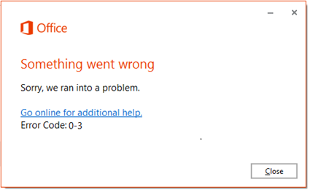
Office Error
Error due to data editing, coding , or analysis errors
Notes:
The last type of error is researcher’s error, or office error.
It’s the error due to …

Slide 23
Total Error is the Key
The goal is to decrease overall error, not any one source of error
Sampling Error
Noncoverage Error
Nonresponse Error
Response Error
Recording Error
Office

Slide 24
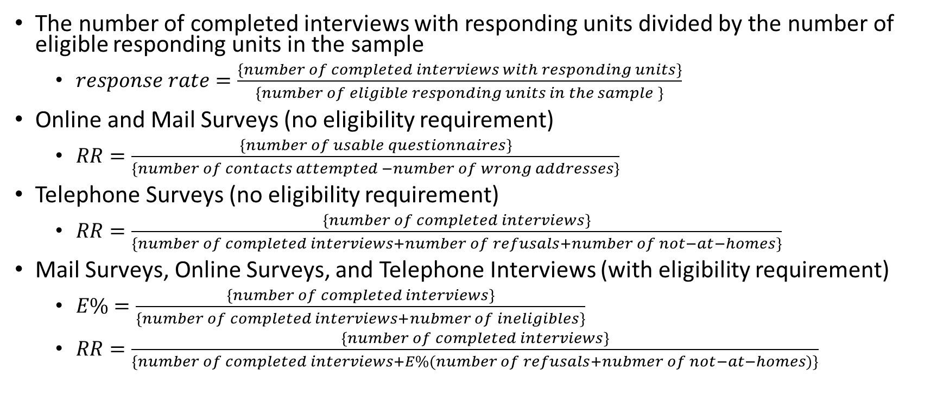
Calculating Response Rates
The number of completed interviews with responding units divided by the number of eligible responding units in the sample
$response rate=\frac{\left\{number of completed interviews with responding units\right\}}{\left\{number of eligible responding units in the sample \right\}}$
Online and Mail Surveys (no eligibility requirement)
$RR=\frac{\left\{number of usable questionnaires\right\}}{\left\{number of contacts attempted −number of wrong addresses\right\}}$
Telephone Surveys (no eligibility requirement)
$RR=\frac{\left\{number of completed interviews\right\}}{\left\{number of completed interviews+number of refusals+number of not−at−homes\right\}}$
Mail Surveys, Online Surveys, and Telephone Interviews (with eligibility requirement)
$E\%=\frac{\left\{number of completed interviews\right\}}{\left\{number of completed interviews+nubmer of ineligibles\right\}}$
$RR=\frac{\left\{number of completed interviews\right\}}{\left\{number of completed interviews+E\%(number of refusals+nubmer of not−at−homes)\right\}}$

Slide 25
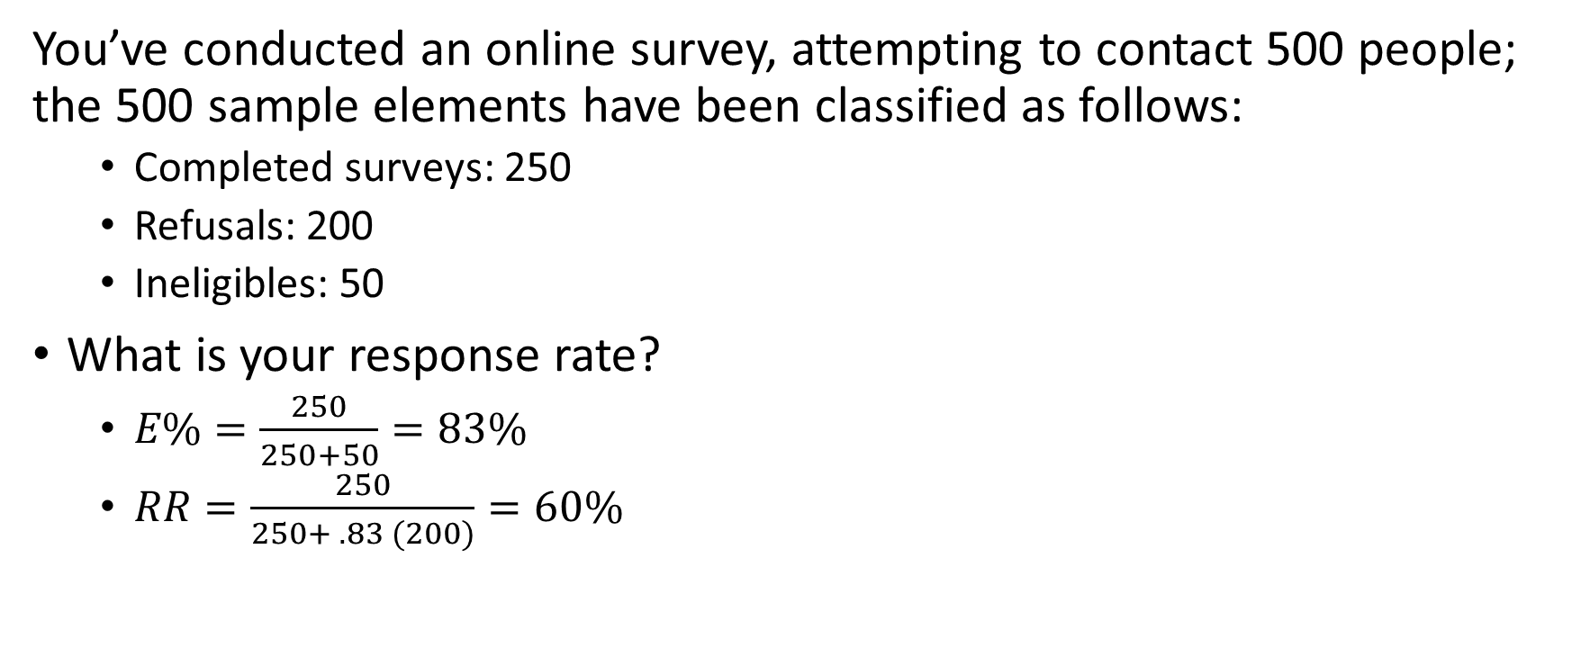
Calculating Response Rates - Example
You’ve conducted an online survey, attempting to contact 500 people; the 500 sample elements have been classified as follows:
Completed surveys: 250
Refusals: 200
Ineligibles: 50
What is your response rate?
$E\%=\frac{250}{250+50}=83\%$
$RR=\frac{250}{250+ .83 (200)}=60\%$
Notes:
Go back to the last slide, ask what formula should we use with online survey with eligibility requirement

Slide 26


Improving Response Rates
The response rate on a project serves as an indicator of the overall quality of a data collection effort. It also provides insight into the likely influence of nonresponse errors on the project
Researchers must strive to obtain the highest response rates possible in a given situation

Slide 27
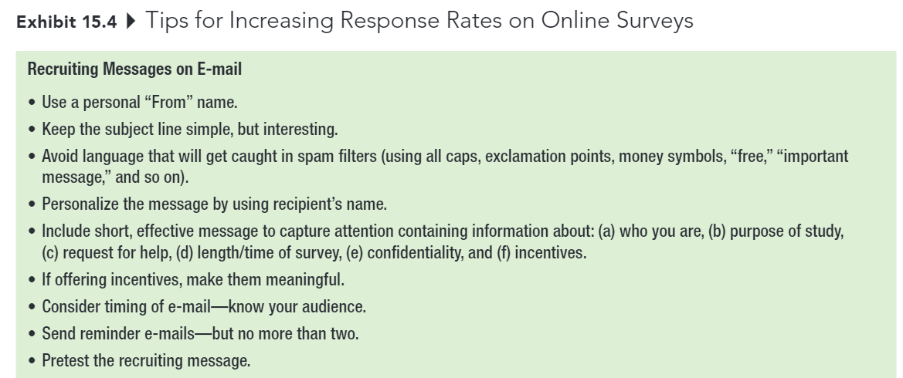
Improving Response Rates
Notes:
As mentioned above, here are a few tips for increasing response rates on online surveys
Keep in mind, that companies did their research to come up with these tips.
Talk about:
Personal From name
Spam
Incentive (can also personalize)

Slide 28
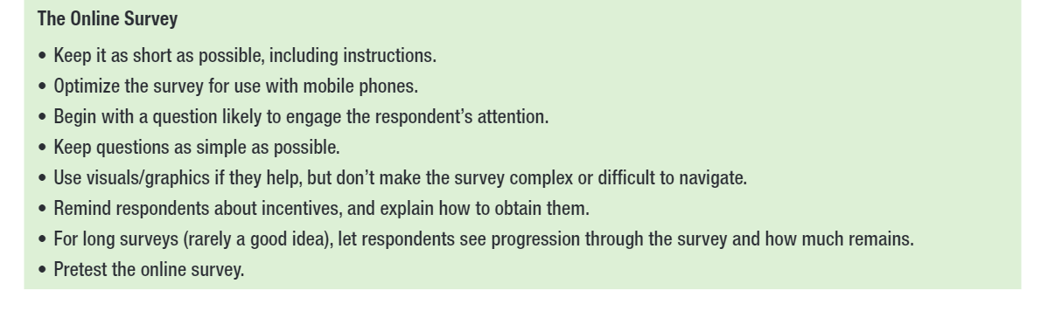
Improving Response Rates

Slide 29
Improving Response Rates
Respondent’s interest in the topic
Survey length
Guarantee of confidentiality or anonymity
Interviewer characteristics and training
Personalization
Response incentives
Follow-up surveys
Notes:
These are a few more suggestions to improve response rates
I just want to highlight that with surveys that ask about sensitive matters, please remember to guarantee confidentiality or anonymity

Slide 30
Discussion Case #6
Mediacom is in the process of changing its package and pricing structure for cable TV and internet services. It has developed four media packages and wants to assess the relative attractiveness of these four packages in a representative sample of customers and potential customers in Columbia, MO. Their researcher is considering the following sampling procedures.
Include a survey with the monthly billing statement, along with a pre-paid postage reply envelope.
Do a mall intercept survey at Columbia Mall and survey 500 actual or potential Mediacom customers.
Conduct an internet survey. Respondents would be paid $2 for completing a survey and would be recruited through banner ads on local newspapers, television, and radio websites.
Discuss how representative of the target population each of these approaches would be. Also, suggest a better option for collecting the data.
Notes:
For this case study, you will help Mediacom decide the best approach to survey their customers.
There will be three alternatives presented here.
Like discussion case 5, you will have to discuss each alternative, then suggest the best option in your opinion and argue for it.
Please remember to respond to 2 other posts and link your answer to the textbook chapter

Slide 31
15-min group discussion
Discuss how you plan to sample (online, in-person, phone interview, etc.)
Swap your survey with another group to get more feedback on your survey
Notes:
Regarding today’s discussion
Please discuss …

Slide 32
Up Next
Assignment 4.5 (update assignment 4)
Week 7 Quiz
First Exam (Monday)
Notes:
I’ll talk more about discussion case 6 and the example

Slide 33
First Exam
Chapters 8 to 15, with a heavy emphasis on chapters 8, 12, and 15
Please review my slides (especially iClicker questions).
30 questions (150 points) within 75 mins
Notes are allowed
Lockdown Browser is required
1 attempt only
Online
Open during the class hour
Notes:
Read the slide
You can take it wherever you want. However, I strongly encourage you to come to class with your laptop to take the exam.
I will be in class to answer any questions if you have during the exam. But I can’t answer it if you are elsewhere, so keep it in mind.
It will be open from
Please don’t think that since you are allowed to open your notes, you don’t need to study anything for the first exam.
I’d strongly recommend you create your own notes so it can serve as a study opportunity, and you can know exactly where to look for during the exam.
Because you can’t start reading your textbook chapters or slides during your exam, you only have limited time, you can only look quickly for the answer in your notes and answer it.

Slide 34



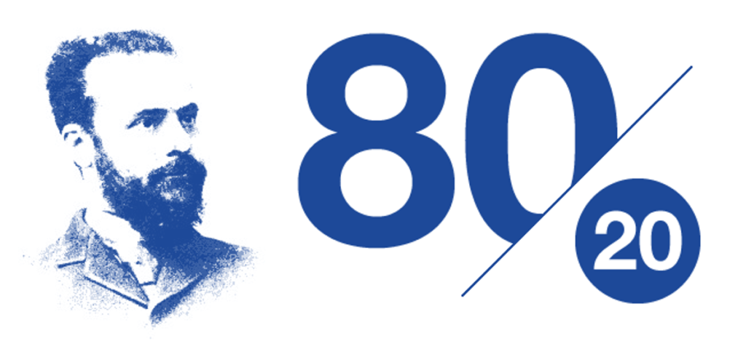
5-min Snippet Wealth Distribution
Pareto Distribution
People wander to gather grains
Each tick (each time), a person eats aa certain amount of grain (metabolism)
People have life expectancy (they die either (1) lifespan runs out, or (2) out of grain)
People do reproduce (offspring has a random metabolism and has a random amount of grain)
Notes:
This model simulates the distribution of wealth. "The rich get richer and the poor get poorer" is a familiar saying that expresses inequity in the distribution of wealth. In this simulation, we see Pareto's law, in which there are a large number of "poor" or red people, fewer "middle class" or green people, and many fewer "rich" or blue people.
Pareto was an Italian civil engineer, sociologist, economist, political scientist, and philosopher. He made several important contributions to economics, particularly in the study of income distribution and in the analysis of individuals' choices. He was also responsible for popularizing the use of the term "elite" in social analysis.
The Pareto principle states that for many outcomes, roughly 80% of consequences come from 20% of causes (the “vital few”). Other names for this principle are the 80/20 rule, the law of the vital few, or the principle of factor sparsity.
Each patch has an amount of grain and a grain capacity (the amount of grain it can grow).
People collect grain from the patches, and eat the grain to survive. How much grain each person accumulates is his or her wealth.
The model begins with a roughly equal wealth distribution. The people then wander around the landscape gathering as much grain as they can. Each person attempts to move in the direction where the most grain lies.
Each time tick, each person eats a certain amount of grain. This amount is called their metabolism.
People also have a life expectancy. When their lifespan runs out, or they run out of grain, they die and produce a single offspring. The offspring has a random metabolism and a random amount of grain, ranging from the poorest person's amount of grain to the richest person's amount of grain. (There is no inheritance of wealth.)
Things to notice:
Notice the distribution of wealth. Are the classes equal?
This model usually demonstrates Pareto's Law, in which most of the people are poor, fewer are middle class, and very few are rich. Why does this happen?
Do poor families seem to stay poor? What about the rich and the middle class people?

